Slide 1
A Web Site: Talking Hands to Reduce Communication Gap with Hearing and Speech Impaired Persons
Group Members
BILAL ABBAS M.FAIZAN Shafiq
(UW-14-CPS-BS-142) (UW-14-CPS-BS-136)
Supervised By
Dr. Saima Gulzar Ahmad

Slide 2
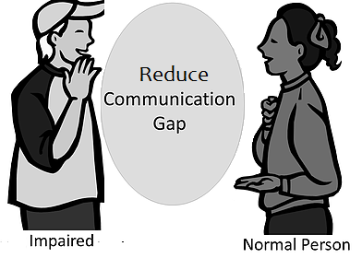
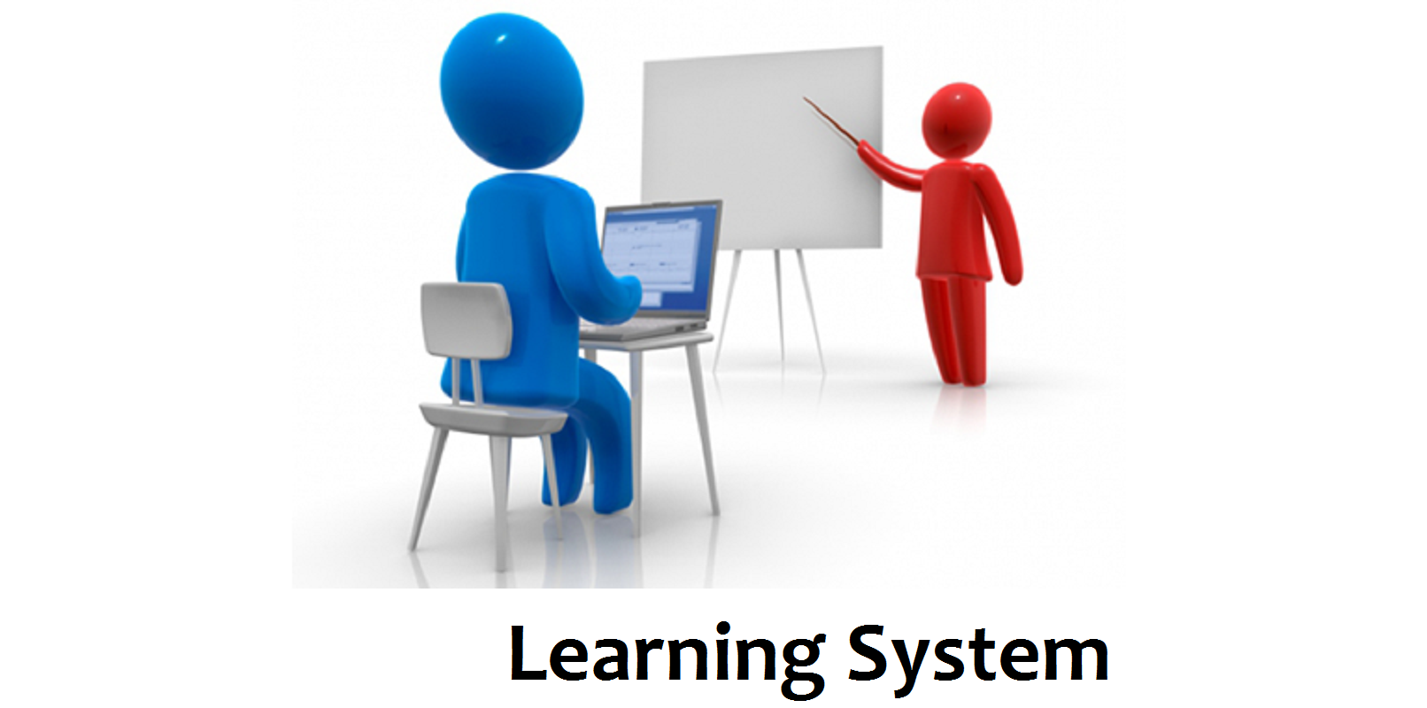
Introduction
Web Base Communication System

Slide 3
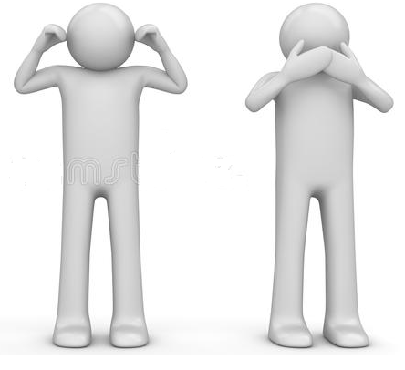
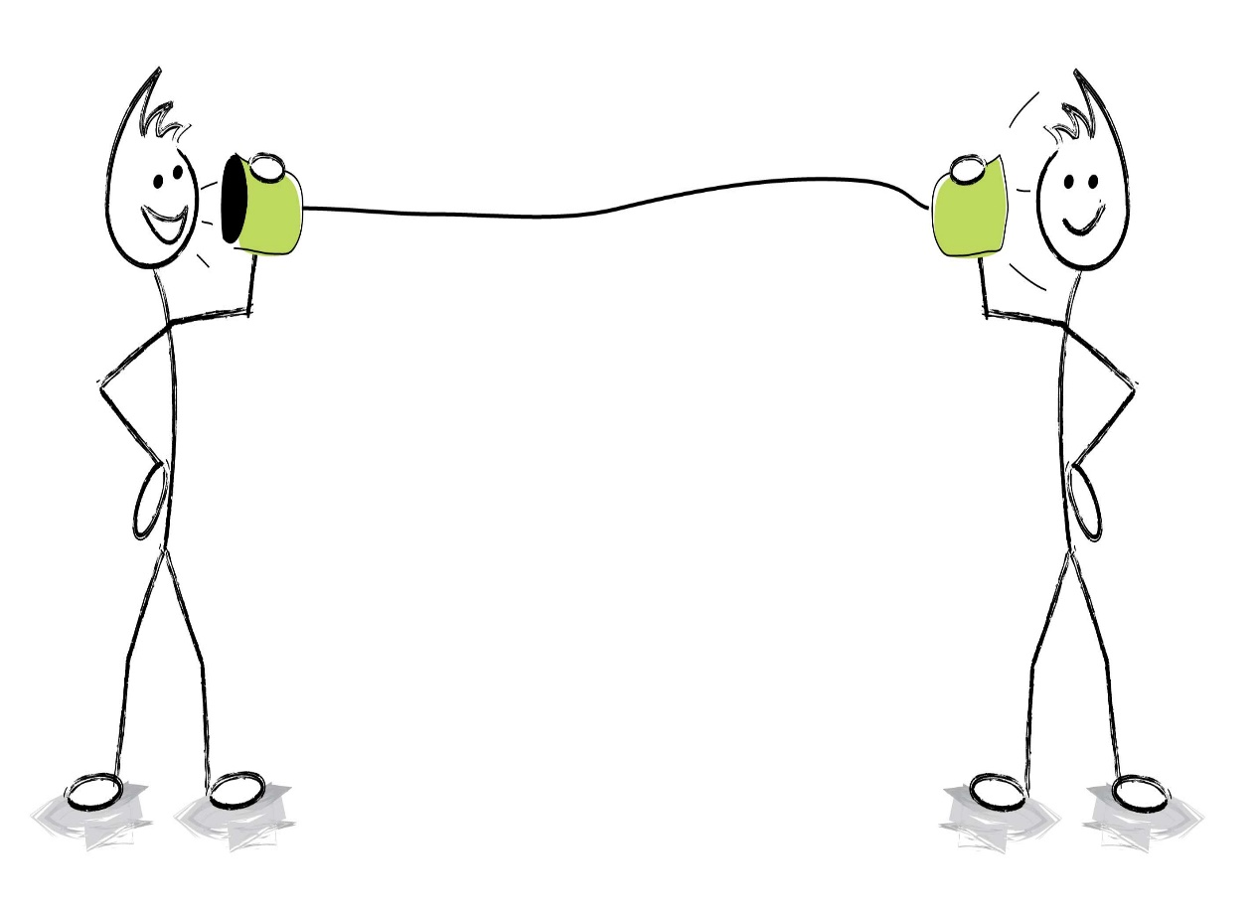
Intro Cont.
System Design: Target Audience
For Deaf and Dumb Person. 2. For Normal Person.

Slide 4
Motivation/Objectives
Motivation:
70-80 million people depend on sign languages to communicate with one another.
According to UNESCO 5% of the world and 1.4 million of Pakistani disabled people have no access to special schools [1].
System Objectives:
Reducing communication gap
Learning ASL
Knowledge evaluation

Slide 5
Related Work
Full Duplex Communication System for Deaf & Dumb People [2]
Limitation:
Use of hardware like glove
Real Time Sign Language Processing System[3]
Limitation:
Time consuming system
Smart Communication System for Deaf-Dumb People [4]
Limitation:
Use of hardware like Xbox360, Sensors.
Many other similar systems

Slide 6
Related Work Cont.
Other system are
Wi-See Technology.
Aawaaz System.
Real Time Sign Language Processing System.
Android based Portable Hand Sign Recognition System.

Slide 7
Proposed Work
We have developed a system which is
Software based System for reducing communication gap.
System used to learn American Sign Language.
Low cost system available to everyone.
System with extendable database.

Slide 8
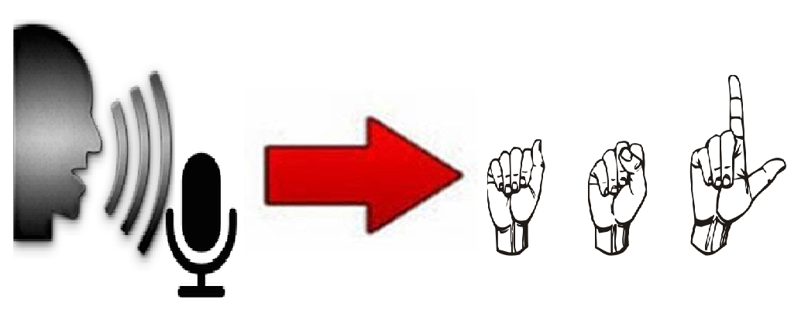


Phases
Mainly 3 basic phases.
Speech to Sign 2. Text to Speech
3. Learning System

Slide 9
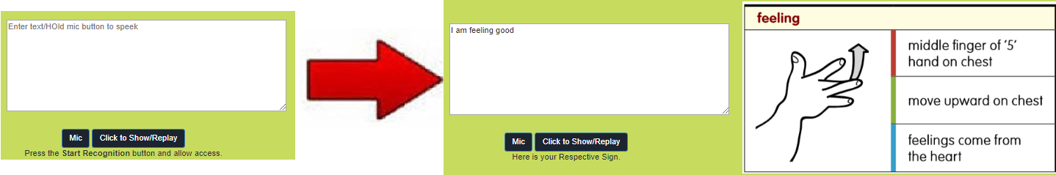
Speech to Sign

Slide 10
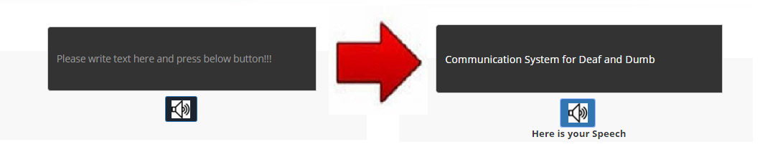
Text to Speech

Slide 11
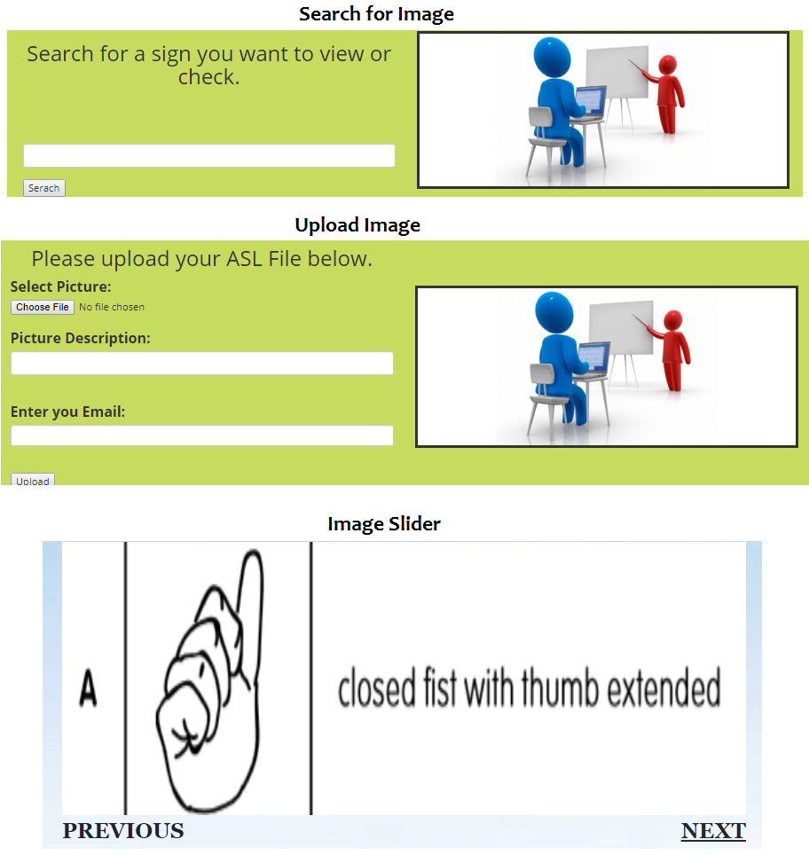
Learning System

Slide 12
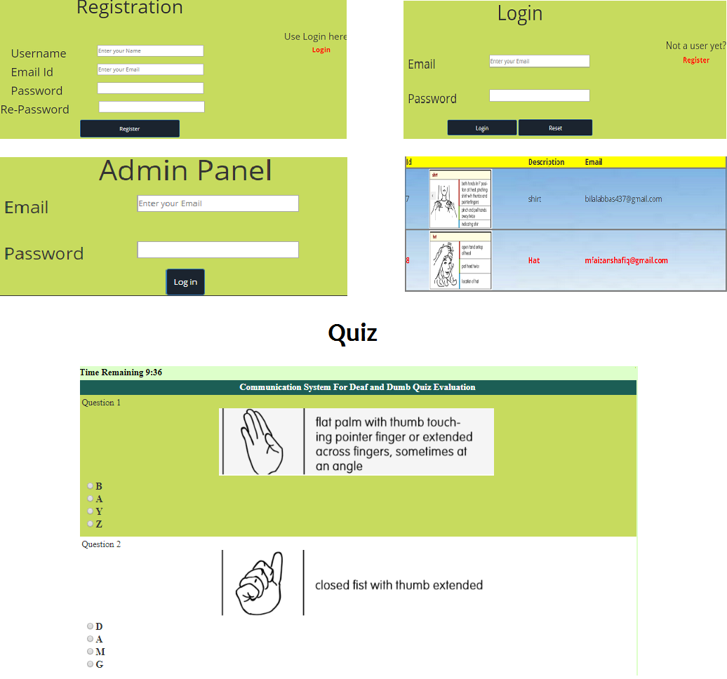
Other Functionalities

Slide 13
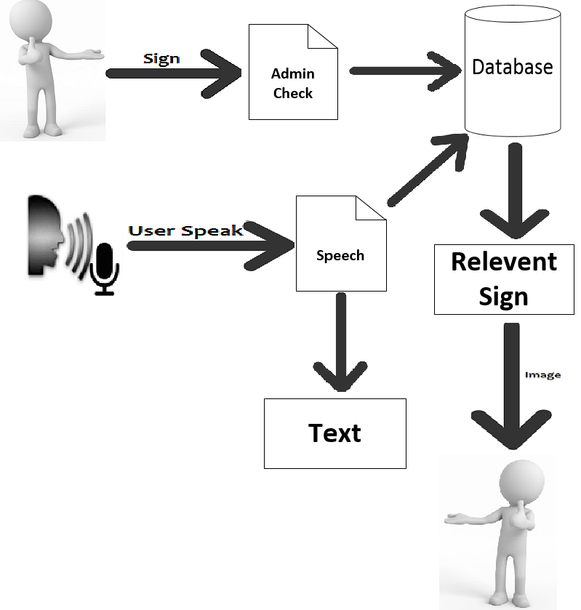

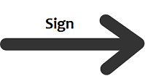
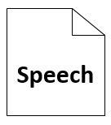


Summary

Slide 14
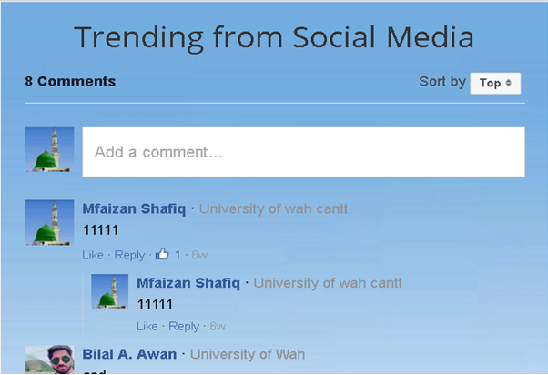
Feedback

Slide 15
Conclusion and Future Work
Conclusion:
Communication with disable people have become more important to make such neglected people a useful member of society.
There are many systems that has been developed so but some systems are hardware based while some are costly and not user friendly.
Our proposed system is software system, low cost and affordable system which could be beneficial for both normal and impaired people.
Future Work:
Proposed system will be upgraded time by time based on user feedback.
Database will be increased in order to satisfy maximum users.

Slide 16
References
[1] Stephan Roman Regional Director, South Asia. Fiona Bartels-Ellis Global Head of Equal Opportunity & Diversity. Peter Upton Country Director, Pakistan. A custom research report produced for the British Council August 2014.Report By UNESCO.
[2] Ghorpade, Shraddha R., and Surendra K. Waghamare. "Full Duplex Communication System for Deaf & Dumb People." International Journal of Emerging Technology and Advanced Engineering (IJETAE) 5.5 (2015).
[3] Seth, Dibyabiva, et al. "Real Time Sign Language Processing System." International Conference on Smart Trends for Information Technology and Computer Communications. Springer, Singapore, 2016.
[4] Abdel-Masieh, Mina M., Manuel M. Nasief, and Maher M. Abdel-Aziz. "Smart Communication System for Deaf-Dumb People."

